Slide 1
Dress Code
A PBIS Presentation

Slide 2
Dress Code at Southeast Raleigh High School
Wake County Policy
Discipline Matrix
Wear This, Not That

Slide 3
Wake County and School Policy
To help keep our students focused on learning without distractions, we expect each one to dress appropriately. Our Code of Conduct prohibits disruptive, provocative, revealing, profane, vulgar, offensive, obscene or unsafe clothing or bodily appearances.

Slide 4
Examples of Inappropriate Dress
exposed undergarments
sagging pants
see-through or excessively short, tight or revealing clothes
bare midriff or strapless shirts
clothing with lewd, indecent or vulgar messages or illustrations
clothing that advertises products or services illegal to minors
head coverings
chains, spikes or other accessories that could be perceived as or used as a weapon
clothing that violates the school system's policies against gang and gang-related activities

Slide 5
Tank Tops:
Guys may wear Tank Tops
BUT……straps must be 2 inches across and can not expose pectoral, lateral or oblique muscles.
Think about looking like a professional when you come to school.

Slide 6
Consequences Cont’d
Level 1 Violation—Administrative Action
Level I Violation | 1st Offense | 2nd Offense | 3rd Offense (Referral in SIRS)
Inappropriate Dress | Warning and change attire | Care until clothing is brought | 1 day CARE and Parent Contact

Slide 7
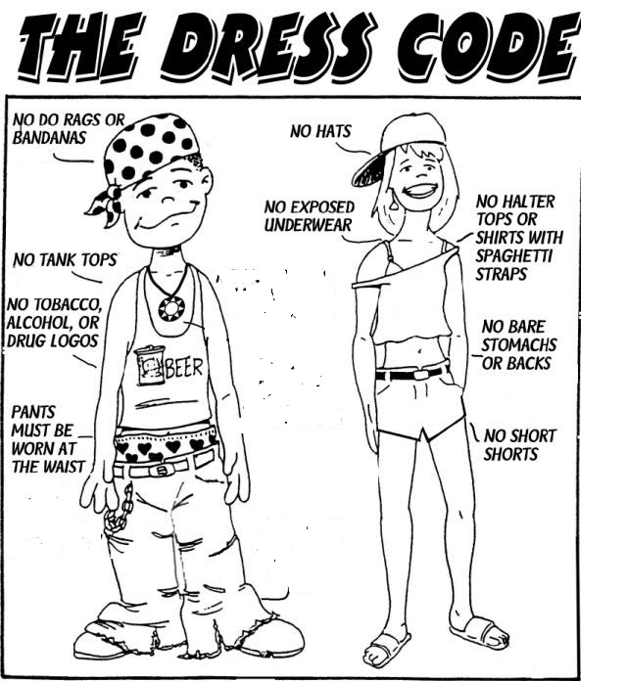

Slide 8
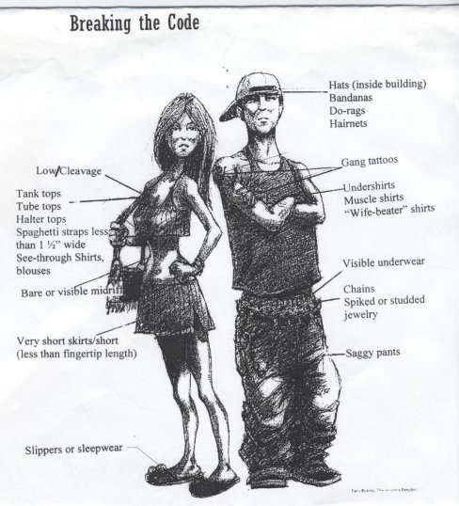

Slide 9
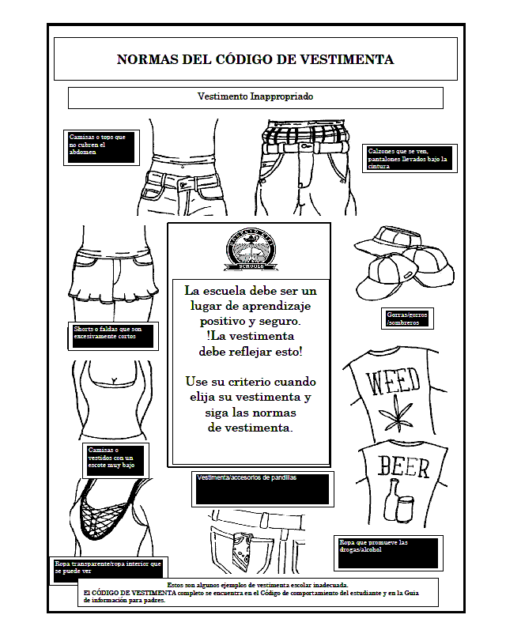

Slide 10
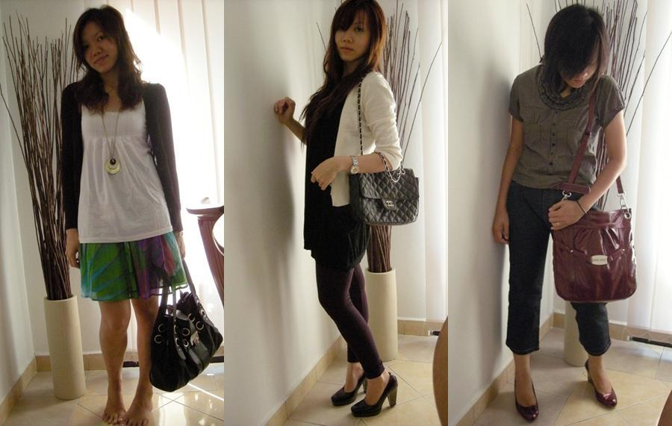
OK to Wear…

Slide 11
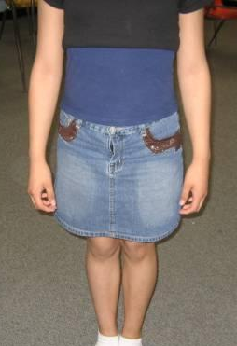
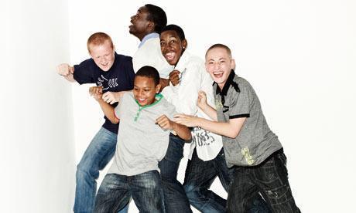
OK to Wear…

Slide 12
And please! Dress for Success! Every Thursday School Wide Dress for Success!

